Slide 1



Group 3
GROUP 3 - KARU. Phase 2 Project
Benbellah Owino
Keziah Murugami
Marion Kung’a
Tricia Too
Crispus Mutua
17TH NOVEMBER 2025

Slide 2



Group 3
Business Problem
Your company now sees all the big companies creating original video content and they want to get in on the fun. They have decided to create a new movie studio, but they don’t know anything about creating movies. You are charged with exploring what types of films are currently doing the best at the box office. You must then translate those findings into actionable insights that the head of your company's new movie studio can use to help decide what type of films to create.

Slide 3

Group 3
Identify High Performing Movie Genres
Objectives
Analyze Audience and Market Trends
Identify Top Performing Studios

Slide 4



Group 3
Data Description
Data used is from many sources and includes information such as movie titles, budgets, revenue, genre, synopsis, studio and directors.
The movie datasets are from:
  Box Office Mojo - a website that tracks box office revenue for films, providing detailed statistics and analysis of movie earnings
  IMDB - an online database of information related to films, television series, podcasts, video games, and streaming content online
  Rotten Tomatoes- review-aggregation website for film and television.
  TheMovieDB - a community-built movie and TV database
  The Numbers

Slide 5


Group 3
Process Steps
We followed the following steps:
  Data Loading
  Data Cleaning
  Data Analysis and Visualization

Slide 6

Group 3
Data Loading
In the Data Loading step, we loaded the datasets into pandas to create dataframes that we used in the subsequent processes of the project.
Data Cleaning
Process Steps
We dropped duplicates, handled missing values by dropping and filling where applicable and converted columns into more usable format

Slide 7


Group 3
Data Analysis Process
Findings and Recommendations
Visualizations
Hypothesis Testing
Created charts to visualize data and trends
Formulated null and alternative hypothesis and tested the data
From the visualizations and hypothesis testing results, we made inferences for better success of the movies studio

Slide 8
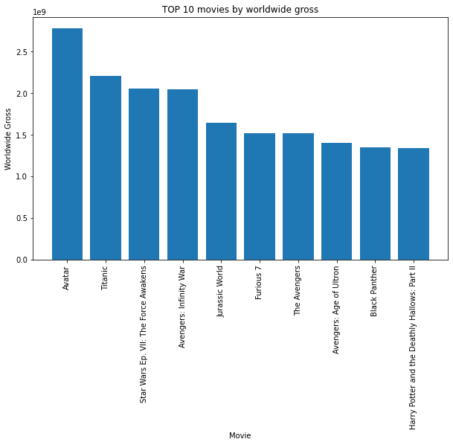
Top 10 movies by worldwide gross
Insight:
Sci-Fi and Hero movies populate the top 10 movies in the worldwide gross.

Slide 9
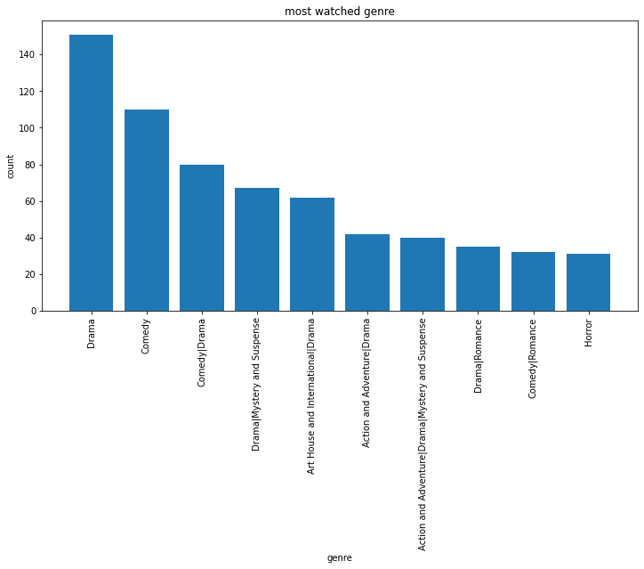
Most Watched Genres
Insight:
Drama Genre has the highest demand compared to other genres.

Slide 10
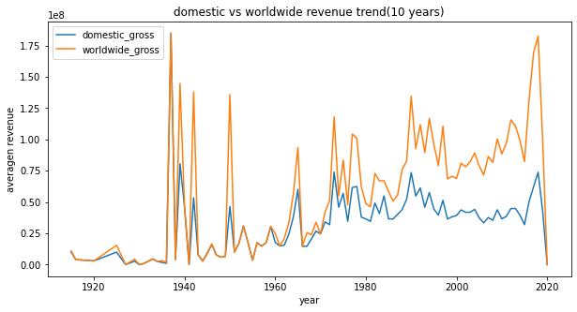
Insight:
Worldwide gross has higher revenue as compared to the domestic gross

Slide 11
Group 3
The studio should contain movies such as The gallows that fall under WB (NL) .
For high chances of success the studio should consider high budget movies which tend to have a greater success.
The studio should invest in Sci-Fi and Hero genres since they have the highest demand.
The studio should consider world wide movies since they tend to have a greater income compared to the others.
Recommendations

Slide 12


Group 3
Conclusion
The studio should focus on Sci-fi and Drama Genres .It should also produce movies that appeal to the worldwide market. The studio should heavily invest in movies to increase chances of success.

Slide 13

Group 3
Thank You

